Slide 1
ENG 346 Data Structures and Algorithms for Artificial Intelligence Stacks and Queues
Dr. Mehmet PEKMEZCİ
mpekmezci@gtu.edu.tr
https://github.com/mehmetpekmezci/GTU-ENG-346

Slide 2
Agenda
Abstract Data Types
Stacks
Queues

Slide 3
Abstract Data Types
High-level description of a collection of data and the operations that can be performed on that data.
Benefits:
Data Structure Abstraction: Behavior of a data structure.
Operations: A set of operations that can be performed on the data.
Encapsulation: Encapsulate the data and operations into a single unit.
Reusability: Reuse in different applications.
Notes:
An Abstract Data Type (ADT) is a high-level description of a collection of data and the operations that can be performed on that data. It defines a logical model for data organization, independent of any specific programming language or implementation details. In essence, it's a way to specify what a data structure can do without specifying how it should be implemented.
Abstract data types are important in computer science and software engineering because they allow you to separate the interface (the methods and operations that can be performed) from the underlying implementation. This separation of concerns makes it easier to design, understand, and maintain complex software systems.
Here are a few key points about abstract data types:
Data Structure Abstraction: ADTs describe the behavior of a data structure, not its internal details. For example, you can define a stack ADT without specifying whether it's implemented using an array or a linked list.
Operations: ADTs specify a set of operations that can be performed on the data, such as adding, removing, or accessing elements. These operations are often defined by a contract or interface.
Encapsulation: ADTs encapsulate the data and operations into a single unit. Users of the ADT can interact with the data structure through its defined interface without needing to know how it's implemented internally.
Reusability: ADTs promote code reusability because you can implement the same ADT in different programming languages or use existing ADTs in various applications without having to rewrite the core logic.

Slide 4
ADTs – continued
List: List of elements accessible by positions.
Dictionary: Key-value pairs.
Set: Collection of distinct elements.
Stack: Follows Last-In-First-Out (LIFO) principle.
Queue: Follows First-In-First-Out (FIFO) principle.
Graph: Vertices and using edges.

Slide 5
Stacks
Insertions and deletions from the same end of the list.
Follow the last-in first-out scheme
Main Operations | Auxiliary Operations
S.push(item) | item = S.top()
item = S.pop() | len(S)
 | S.is_empty()

Slide 6
Stacks – continued
General Applications
Function’s call stack
Internet Browser history
Editor undo/redo
…
Algorithm design
Reverse polish notation
…

Slide 7
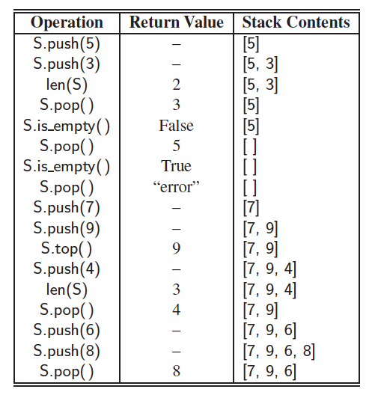
Stacks – Example

Slide 8
Array-Based Stack Implementation
class Stack:
def __init__(self, size=10):
pass
def push(self, data):
pass
def pop(self):
pass
def is_empty(self):
pass
def top(self):
pass
def __len__(self):
pass
def display(self):
pass
Notes:
https://www.procoding.org/stack-using-array

Slide 9
Example – Parenthesis Matching
Algorithm ParenthesisMatching(X, n):
Input: An array X of n tokens, each of which is either a grouping symbol, a
variable, an arithmetic operator, or a number
Output: true if and only if all the grouping symbols in X match
Let S be an empty stack
for i=0 to n-1 do
if X[i] is an opening grouping symbol then
S.push(X[i])
else if X[i] is a closing grouping symbol then
if S.is_empty() then
return false {nothing to match with}
if S.pop() does not match the type of X[i] then
return false {wrong type}
if S.isEmpty() then
return true {every symbol matched}
else return false {some symbols were never matched}
Notes:
Also: https://www.procoding.org/balanced-brackets-problem

Slide 10
Reverse Polish Notation
Mathematical notation: Infix, operators are between operands.
E.g.: 2 + 3 * (4 + 7)
Polish Notation: Prefix, operators before operands.
E.g.: + 2 * 3 + 4 7
Reverse Polish Notation: Postfix, operators follow operands.
E.g.: 2 3 4 7 + * +

Slide 11
Example – Reverse Polish Notation Calculator
Using Stack

Slide 12
Queues
Insertions to the end, deletions from the front of the list.
Follow the first-in first-out scheme
Main Operations | Auxiliary Operations
Q.enqueue(item) | item = Q.first()
item = Q.dequeue() | len(Q)
 | Q.is_empty()

Slide 13
Queues – continued
General Applications
Waiting lists
Access to shared resources (e.g., printer)
Round Robin Scheduler
…
Algorithm design
…

Slide 14
Array-based Queue Implementation
Use an array of size N in a circular fashion
Two variables keep track of the front and rear
f index of the front element
r index immediately past the rear element
Array location r is kept empty
normal configuration
Q
0
1
2
f
r
wrapped-around configuration
Q
0
1
2
r
f

Slide 15
Queue Operations
We use the modulo operator (remainder of division)
Algorithm size()
return (N − f + r) mod N
Algorithm isEmpty()
return (f = r)
Q
0
1
2
f
r
Q
0
1
2
r
f

Slide 16
Queue Operations (cont.)
Operation enqueue throws an exception if the array is full
This exception is implementation-dependent
Algorithm enqueue(o)
if size() = N − 1 then
throw FullQueueException
else
Q[r] ← o
r ← (r + 1) mod N
Q
0
1
2
f
r
Q
0
1
2
r
f

Slide 17
Queue Operations (cont.)
Operation dequeue throws an exception if the queue is empty
This exception is specified in the queue ADT
Algorithm dequeue()
if isEmpty() then
throw EmptyQueueException
else
o ← Q[f]
f ← (f + 1) mod N
return o
Q
0
1
2
f
r
Q
0
1
2
r
f

Slide 18
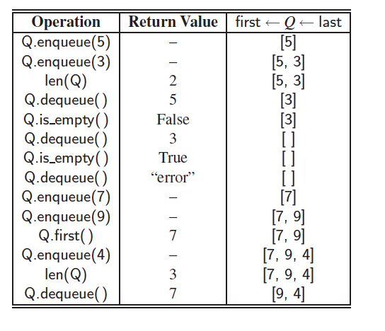
Queues – Example

Slide 19
Array Based Queue Implementation
class Queue:
def __init__(self, c=10):
pass
def is_empty(self):
pass
def enqueue(self, data):
pass
def dequeue(self):
pass
def __len__(self):
pass
def display(self):
pass
def first(self):
pass
Notes:
https://www.procoding.org/stack-using-array

